Slide 1


Welcome to Machine learning Workshop day - 2

Slide 2

TODAYS AGENDA
Logistic Regression Implementation
KNN Algorithm
Decision Tree Algorithm
Capstone Project: Crop Recommendation System

Slide 3

Decision Tree algorithm
Decision Tree algorithm belongs to the family of supervised learning algorithms.
This algorithm can be used for solving both classification and regression algorithm.
The goal of using a Decision Tree is to create a training model that can use to predict the class or value of the target variable by learning simple decision rules inferred from prior data(training data).

Slide 4
Types of decision trees
Categorical Variable Decision Tree: Decision Tree which has a categorical target variable then it called a Categorical variable decision tree.
Continuous Variable Decision Tree: Decision Tree has a continuous target variable then it is called Continuous Variable Decision Tree.

Slide 5

Important terms
Root Node: It represents the entire population or sample and this further gets divided into two or more homogeneous sets.
Splitting: It is a process of dividing a node into two or more sub-nodes.
Decision Node: When a sub-node splits into further sub-nodes, then it is called the decision node.
Leaf / Terminal Node: Nodes do not split is called Leaf or Terminal node.
Pruning: When we remove sub-nodes of a decision node, this process is called pruning. You can say the opposite process of splitting.
Branch / Sub-Tree: A subsection of the entire tree is called branch or sub-tree.
Parent and Child Node: A node, which is divided into sub-nodes is called a parent node of sub-nodes whereas sub-nodes are the child of a parent node.

Slide 6
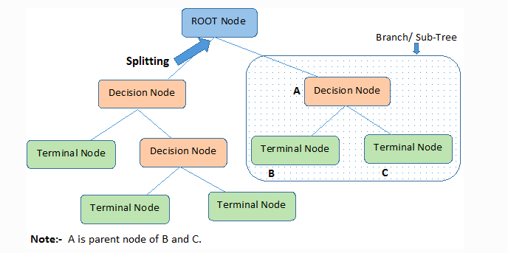

Slide 7
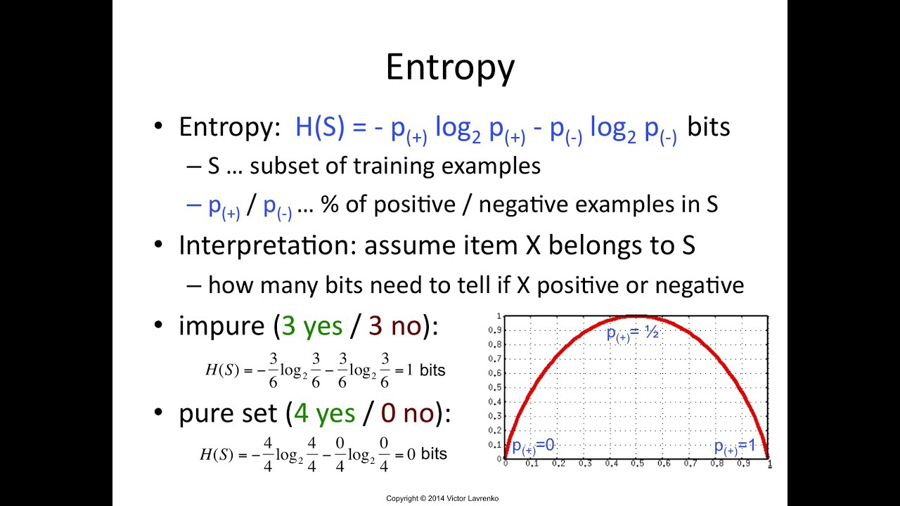

Slide 8
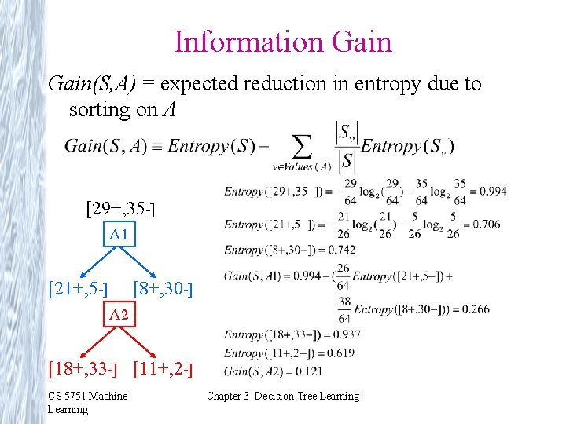

Slide 9
ID3 algorithm for building decision tree
It begins with the original set S as the root node.
On each iteration of the algorithm, it iterates through the very unused attribute of the set S and calculates Entropy(H) and Information gain(IG) of this attribute.
It then selects the attribute which has the smallest Entropy or Largest Information gain.
The set S is then split by the selected attribute to produce a subset of the data.
The algorithm continues to recur on each subset, considering only attributes never selected before.

Slide 10
